Slide 1
Topics to be Covered:
Java AWT Basics
Java AWT Hierarchy
Components/Container classes and their constructors
Event Handling
Listener Interfaces
Adapter classes

Slide 2
Java AWT

Slide 3
Java AWT(Abstract Window Toolkit)
Java AWT (Abstract Window Toolkit) is an API to develop Graphical User Interface (GUI) or windows-based applications in Java.
Java AWT components are platform-dependent i.e. components are displayed according to the view of the operating system. Because Java AWT calls the native platform (operating systems) subroutine for creating API components like TextField, CheckBox, Button, etc.
AWT is heavy weight i.e. its components are using the resources of the underlying operating system (OS).
The java.awt package provides classes for AWT API such as TextField, Label, TextArea, RadioButton, CheckBox, Choice, List etc.

Slide 4
Java AWT Hierarchy

Slide 5
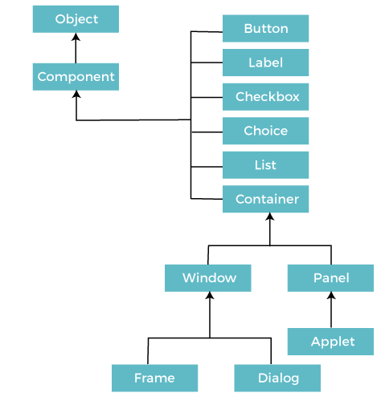
Java AWT Hierarchy

Slide 6
Components & Containers

Slide 7
Java AWT: Components and Containers
Components
All the elements like the button, text fields, scroll bars, etc. are called components. In Java AWT, there are classes for each component. In order to place every component in a particular position on a screen, we need to add them to a container.
Container
The Container is a component in AWT that can contain other components like buttons, textfields, labels, etc.
The classes that extends Container class are known as container such as Frame, Dialog and Panel.
It is basically a screen where the components are placed at their specific locations. Thus it contains and controls the layout of components.
There are three types of containers in Java AWT:
Window
Panel
Frame

Slide 8
Java AWT: Components and Containers
Window
The window is the container that has no borders and menu bars. You must use frame, dialog or another window for creating a window. We need to create an instance of Window class to create this container.
Panel
The Panel is the container that doesn't contain title bar, border or menu bar. It is generic container for holding the components. It can have other components like button, text field etc. An instance of Panel class creates a container, in which we can add components.
Frame
The Frame is the container that contain title bar and border and can have menu bars. It can have other components like button, text field, scrollbar etc. Frame is most widely used container while developing an AWT application.
Useful Methods of Component Class
Method | Description
public void add(Component c) | Inserts a component in the container
public void setSize(int width,int height) | Sets the size (width and height) of the component.
public void setLayout(LayoutManager m) | Defines the layout manager for the component.
public void setVisible(boolean status) | Changes the visibility of the component, by default false.

Slide 9
Java AWT Examples

Slide 10
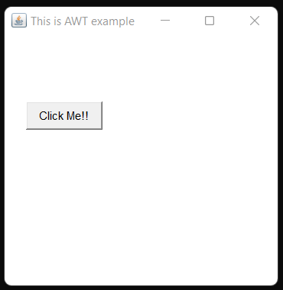
Java AWT: Example
To create simple AWT example, you need a frame. There are two ways to create a GUI using Frame in AWT.
By extending Frame class
By creating the object of Frame class
import java.awt.*;
public class AWTEx1 extends Frame
{
AWTEx1()
{
Button b = new Button("Click Me!!"); // creating a button
b.setBounds(30,100,80,30); // setting button position on screen
add(b); // adding button into frame
setSize(300,300); // frame size 300 width and 300 height
setTitle(“This is AWT example"); // setting the title of Frame
setLayout(null); // No layout manager
setVisible(true); // sets the visibility of frame
}
public static void main(String args[])
{
AWTEx1 f = new AWTEx1();
}
}

Slide 11
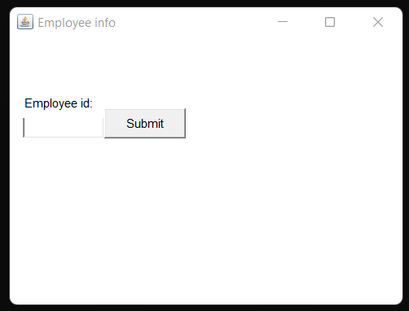
Java AWT: Example
import java.awt.*;
public class AWTEx2
{
AWTEx2()
{
Frame f = new Frame(); // creating a Frame
Label l = new Label("Employee id:"); // creating a Label
Button b = new Button("Submit"); // creating a Button
TextField t = new TextField(); // creating a TextField
// setting position of above components in the frame
l.setBounds(20, 80, 80, 30);
t.setBounds(20, 100, 80, 30);
b.setBounds(100, 100, 80, 30);
// adding components into frame
f.add(b);
f.add(l);
f.add(t);
// frame size 300 width and 300 height
f.setSize(400,300);
// setting the title of frame
f.setTitle("Employee info");
f.setLayout(null); // no layout
f.setVisible(true); // setting visibility of frame
}
public static void main(String args[])
{
AWTEx2 f = new AWTEx2();
}
}

Slide 12
Event Handling

Slide 13
Java AWT: Components and Containers
Changing the state of an object is known as an event. For example, click on button, dragging mouse etc. The java.awt.event package provides many event classes and Listener interfaces for event handling.
Java Event classes and Listener interfaces
Event Classes | Listener Interfaces
ActionEvent | ActionListener
MouseEvent | MouseListener and MouseMotionListener
MouseWheelEvent | MouseWheelListener
KeyEvent | KeyListener
ItemEvent | ItemListener
TextEvent | TextListener
AdjustmentEvent | AdjustmentListener
WindowEvent | WindowListener
ComponentEvent | ComponentListener
ContainerEvent | ContainerListener
FocusEvent | FocusListener

Slide 14
Java AWT: ActionListener in Event Handling
Java ActionListener Interface
The Java ActionListener is notified whenever you click on the button or menu item. It is notified against ActionEvent. The ActionListener interface is found in java.awt.event package.
It has only one method: actionPerformed() : The actionPerformed() method is invoked automatically whenever you click on the registered component.
public abstract void actionPerformed(ActionEvent e);
How to write ActionListener
The common approach is to implement the ActionListener. If you implement the ActionListener class, you need to follow 3 steps:
Implement the ActionListener interface in the class:
public class ActionListenerExample Implements ActionListener
2) Register the component with the Listener:
component.addActionListener(instanceOfListenerclass);
3) Override the actionPerformed() method:
public void actionPerformed(ActionEvent e){
//Write the code here
}

Slide 15
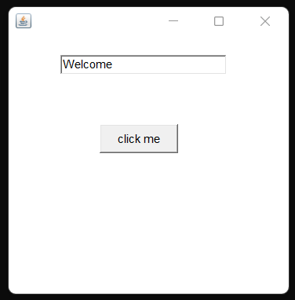
Event handling: within class
import java.awt.*;
import java.awt.event.*;
class AEvent extends Frame implements ActionListener
{
TextField tf;
AEvent()
{
tf=new TextField();
tf.setBounds(60,50,170,20); // Set position
Button b=new Button("click me");
b.setBounds(100,120,80,30);
//register listener
b.addActionListener(this);//passing current instance
//add components and set size, layout and visibility
add(b); add(tf);
setSize(300,300);
setLayout(null);
setVisible(true);
}
public void actionPerformed(ActionEvent e)
{
tf.setText("Welcome");
}
public static void main(String args[])
{
new AEvent();
}
}

Slide 16
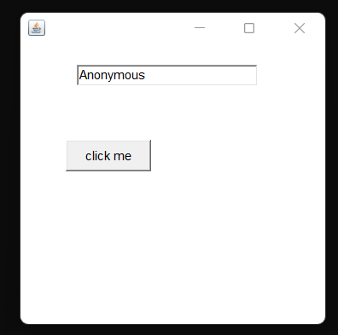
Event handling: by using anonymous class
import java.awt.*;
import java.awt.event.*;
class AEvent1 extends Frame implements ActionListener
{
TextField tf;
AEvent1()
{
tf=new TextField();
tf.setBounds(60,50,170,20); // Set position
Button b=new Button("click me");
b.setBounds(100,120,80,30);
b.addActionListener(new ActionListener() {
public void actionPerformed(ActionEvent e)
{
// Setting text to field
tf.setText("Anonymous");
}
});
add(b); add(tf);
setSize(300,300);
setLayout(null);
setVisible(true);
}
public static void main(String args[])
{
new AEvent1();
}
}

Slide 17
Event handling: TextArea
// This program will count total words and characters entered in the textarea
import java.awt.*;
import java.awt.event.*;
public class TAreaEx extends Frame implements ActionListener{
Label l1, l2;
TextArea area;
Button b;
TAreaEx()
{
l1 = new Label();
l1.setBounds(50, 50, 100, 30);
l2 = new Label();
l2.setBounds(160, 50, 100, 30);
area = new TextArea();
area.setBounds(20, 100, 300, 300);
b = new Button("Count Words");
b.setBounds(100, 400, 100, 30);
b.addActionListener(this);
add(l1);
add(l2);
add(area);
add(b);
// setting the size, layout and visibility of frame
setSize(400, 450);
setLayout(null);
setVisible(true);
}
public void actionPerformed(ActionEvent e)
{
String text = area.getText();
String words[]=text.split("\\s");
l1.setText("Words: "+words.length);
l2.setText("Characters: "+text.length());
}
public static void main(String[] args)
{
new TAreaEx();
}
}

Slide 18
Event handling: Checkbox
import java.awt.*;
import java.awt.event.*;
public class CheckboxExample1
{
CheckboxExample1()
{
Frame f = new Frame ("CheckBox Example");
final Label label = new Label();
label.setAlignment(Label.CENTER);
label.setSize(400,100);
// creating the checkboxes
Checkbox checkbox1 = new Checkbox("C++");
checkbox1.setBounds(100, 100, 50, 50);
Checkbox checkbox2 = new Checkbox("Java");
checkbox2.setBounds(100, 150, 50, 50);
// adding the checkbox to frame
f.add(checkbox1);
f.add(checkbox2);
f.add(label);
// adding event to the checkboxes
checkbox1.addItemListener(new ItemListener() {
public void itemStateChanged(ItemEvent e) {
label.setText("C++ Checkbox: "
+ (e.getStateChange()==1?"checked":"unchecked"));
}
});
checkbox2.addItemListener(new ItemListener() {
public void itemStateChanged(ItemEvent e) {
label.setText("Java Checkbox: "
+ (e.getStateChange()==1?"checked":"unchecked"));
}
});
f.setSize(400,400);
f.setLayout(null);
f.setVisible(true);
}
public static void main(String args[])
{
new CheckboxExample1();
}
}

Slide 19
Event handling: CheckboxGroup – Radio Button
import java.awt.*;
import java.awt.event.*;
public class CheckboxGroupEx
{
CheckboxGroupEx()
{
Frame f = new Frame (“Radiobutton Example"); final Label label = new Label();
label.setAlignment(Label.CENTER);
label.setSize(400,100);
CheckboxGroup cbg = new CheckboxGroup();
Checkbox checkbox1 = new Checkbox("C “,cbg,false);
checkbox1.setBounds(100, 100, 50, 50);
Checkbox checkbox2 = new Checkbox(“C++“,cbg,false);checkbox2.setBounds(100, 150, 50, 50);
// adding the checkbox to frame
f.add(checkbox1);
f.add(checkbox2);
f.add(label);
// adding event to the checkboxes
checkbox1.addItemListener(new ItemListener() {
public void itemStateChanged(ItemEvent e) {
label.setText("C RadioButton: Checked”);
}
});
checkbox2.addItemListener(new ItemListener() {
public void itemStateChanged(ItemEvent e) {
label.setText("C++ RadioButton: Checked”);
}
});
f.setSize(400,400);
f.setLayout(null);
f.setVisible(true);
}
public static void main(String args[])
{
new CheckboxGroupEx();
}
}

Slide 20
Event handling: Choice box
import java.awt.*;
import java.awt.event.*;
public class ChoiceExample2
{
ChoiceExample2()
{
Frame f = new Frame();
final Label label = new Label();
label.setAlignment(Label.CENTER);
label.setSize(400, 100);
Button b = new Button("Show");
b.setBounds(200, 100, 50, 20);
// creating final object of Choice class
final Choice c = new Choice();
c.setBounds(100, 100, 75, 75);
// adding 5 items to choice menu
c.add("C");
c.add("C++");
c.add("Java");
c.add("PHP");
c.add("Android");
f.add(c);
f.add(label);
f.add(b);
f.setSize(400, 400);
f.setLayout(null);
f.setVisible(true);
// adding an event to the button which displays the
// selected item from the list when button is clicked
b.addActionListener(new ActionListener() {
public void actionPerformed(ActionEvent e) {
String data = "Programming language Selected: "+ c.getItem(c.getSelectedIndex());
label.setText(data);
}
});
}
public static void main(String args[])
{
new ChoiceExample2();
}
}

Slide 21
Thank You

